Slide 1
Data Structures/Big Data
Please turn your phone to silent mode.
Chulalongkorn University
School of Integrated Innovation
Fall 2023
Marko Niinimaki Marko.N@chula.ac.th

Slide 2
Today’s main topics
Where is data? In programs/files/databases/blockchains...
Midterm feedback
From last week (or before: The Python database connection).
What are blockchains? What kinds of data structures and algorithms do they need?
Lab/assignments: Hash tables.

Slide 3
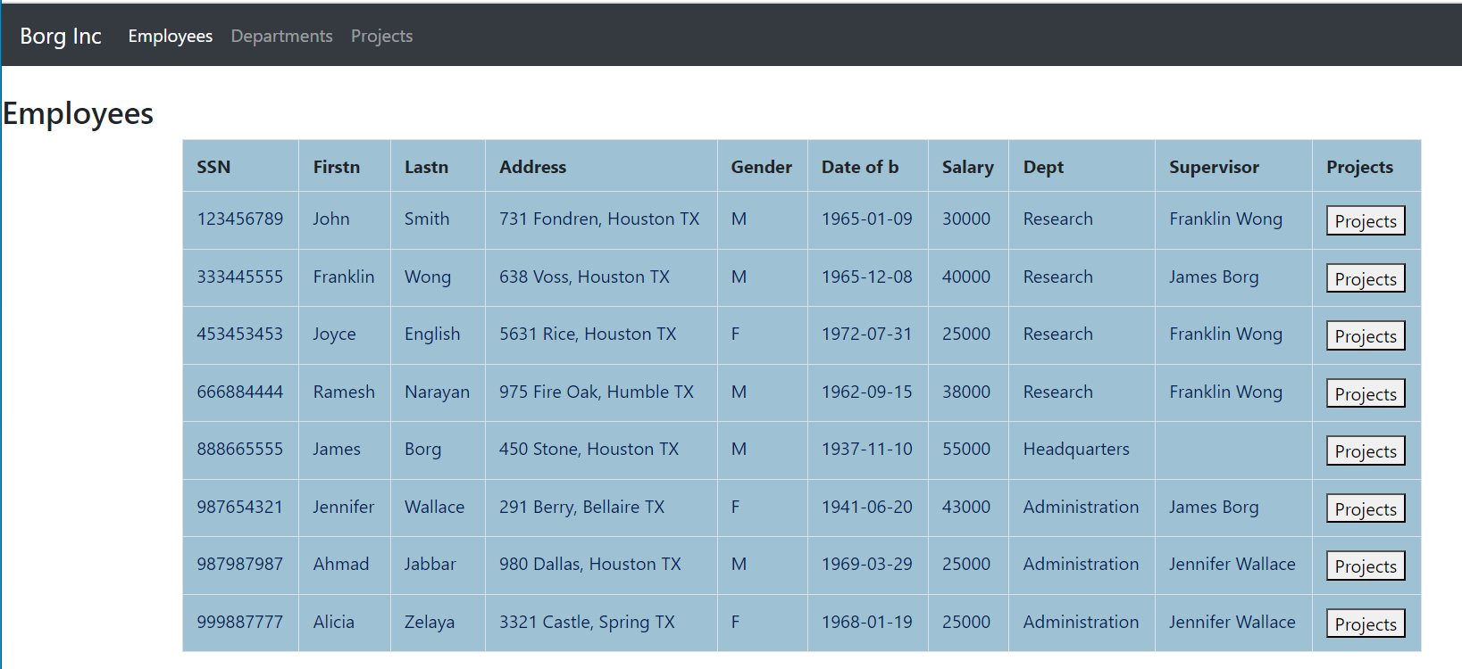
The Python database connection
Using Python, we can access the data in the database using SQL commands that are "embedded" in Python.
So, we can create web applications that communicate with a database.

Slide 4
Midterm feedback
45 students, max 100 points, avg. 79.3
Some specific issues:
Time complexities
Project/Select

Slide 5
Midterm feedback
Related (but not in the exam): We have a list of N integer elements (e.g. 100).
arr = [0] * N
We'd like to fill the list so that it contains the values 1..N in a random order each value just once. What's the best way?
Idea 1: Use random.randind(1,N) in a for loop. For each value, check that it did not appear in the list earlier (another for loop).
Idea 2: Fill the list as a sequence of 1,2,3,4...N. This is O(n). Then "shuffle": select randomly 2 positions and swap the elements in there.

Slide 6
Today’s main topics
Where is data? In programs/files/databases/blockchains...
Midterm feedback
What are blockchains? What kinds of data structures and algorithms do they need?
What is a hash function?

Slide 7
Today’s main topics
What is the data in Bitcoin's blockchain? Why does the narrator compare a hash with a fingerprint? Why do we need the hash of the previous block in the current block? What is proof-of-work? What is "consensus"?
https://www.youtube.com/watch?v=SSo_EIwHSd4 Blockchain 6 min
What is a hash function?
import hashlib
hexval = hashlib.sha256(b"Hello World").hexdigest()
intval = int(hexval, 16)
print(intval)

Slide 8
Hash functions and hash tables
Where is data? In programs/files/databases/blockchains...
https://runestone.academy/ns/books/published/pythonds3/SortSearch/Hashing.html?mode=browsing
Problem: We have "digital objects" like strings or JPEG pictures. We would like to find a specific object as fast as possible.
Partial solution: Since these objects can be compared with each other, we could put them into a list in an ascending order. We can then search the object in the list by using binary search.
But inserting a new object in the list is still a "costly" operation O(n).

Slide 9
Hash functions and hash tables
Better solution (but needs improvement)
Let's have a list of fixed size (an array). For each digital object that we want to put in the array, let's compute its hash function value .. and "fit" it in the array.
Example: Array of strings, size 10, index 0 .. index 9.
import hashlib
hexval = hashlib.sha256(b"Hello World").hexdigest()
intval = int(hexval, 16)
pos = intval % 10
The position for "Hello World" in the array is 4.

Slide 10
Hash functions and hash tables
0​ | 1​ | 2​ | 3​ | 4​ | 5​ | 6​ | 7​ | 8​ | 9​
​ | ​ | ​ | ​ | Hello World​ | ​ | ​ | ​ | ​ | ​
But we'll have a problem when there's another string whose hash value % array size is 4, too.
Solution: use a list of string at each index instead of just a string.

Slide 11
Hash functions and hash tables
0​ | 1​ | 2​ | 3​ | 4​ | 5​ | 6​ | 7​ | 8​ | 9​
​x | ​x | ​x | ​x |  | ​x | ​x | ​x | ​x | ​x
Hello world

Slide 12
Hash functions and hash tables
Application of hash tables: Python dictionaries.
We could create our own implementation (let's not). It could look like this:
class HashTable(Generic[T], tablesize) # We'll cover what "generic" means later
myhashtable = HashTable[string](100) # create a hash table for 100 strings

Slide 13
Hash functions and hash tables
Application of hash tables: Python dictionaries.
Luckily Python has hash tables as a built in data type called a dictionary.
Moreover, Python has a hashing function hash() that applies to almost anything:
https://www.geeksforgeeks.org/python-hash-method : Python hash() function is a built-in function and returns the hash value of an object if it has one. The hash value is an integer which is used to quickly compare dictionary keys while looking at a dictionary.
x =1
print(hash(x))
1
x= "hello"
print(hash(x))
6470543067838380530

Slide 14
Hash functions and hash tables
Application of hash tables: Python dictionaries.
Let's consider finding the most frequent word in a file again. A word's frequency could be a mapping like "love" -> 13 meaning the word love appeared 13 times.
With Python we can just write:
myfreqs = {} # introduce a Python dictionary
myfreqs["love"] = 13 # make a mapping
print(myfreqs["love"])

Slide 15
Hash functions and hash tables
Application of hash tables: Python dictionaries.
Let's consider finding the most frequent word in a file again. A word's frequency could be a mapping like "love" -> 13 meaning the word love appeared 13 times.
With Python we can just write:
myfreqs = {} # introduce a Python dictionary
myfreqs["love"] = 13 # make a mapping
If "love" in myfreqs: # is there a mapping for the word?
print(myfreqs["love"])

Slide 16
Hash functions and hash tables
Application of hash tables: Python dictionaries.
How would we put every word's frequency in the dictionary? Like in your previous example, we first put all the words of the file (text) into a list called words.
myfreqs = {} # introduce a Python dictionary
for word in words:
if word in myfreqs:
myfreqs[word] = myfreqs[word] + 1
else:
myfreqs[word] = 1

Slide 17
Hash functions and hash tables
Application of hash tables: Python dictionaries.
Is this faster that finding the frequencies using nested for loops?
Finding the most frequent word in Pride and Prejudice (~ 125 000 words)
For loops: 300 seconds
Dictionary: 0.2 second

Slide 18
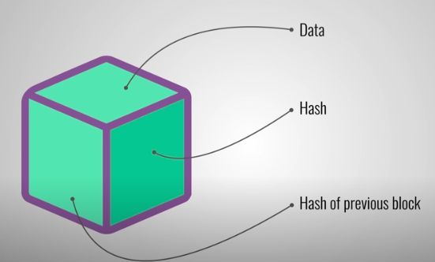
What next?
What has this to do with blockchains?
They contain hashes. "Verifying the chain's integrity" = re-calculating that the hashes are correct. https://www.youtube.com/watch?v=wTC31ZI6QM4 (4 min)
Lab sheet: Lab Week 08 DS-Big Data.

